Slide 1


MEDIA MENGAJAR
BRIGHT AN ENGLISH
FOR SMP/MTs GRADE VIII

Slide 2
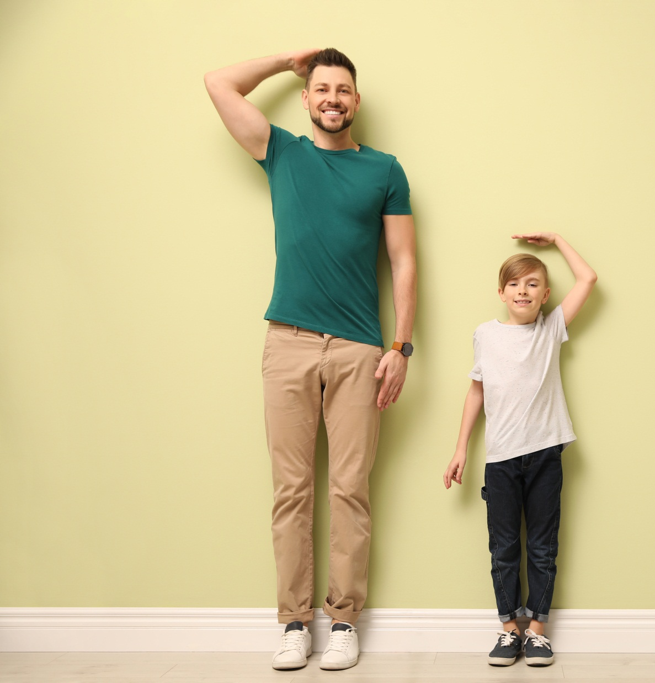
Chapter 7
I’m Taller Than You
Notes:
Jika terdapat gambar cantumkan sumber gambar dgn ukuran font 10pt

Slide 3
A. ……….
In this chapter, we will learn to:
compare two or more things;
identify comparative and superlative adjectives;
use comparative and superlative adjectives in both spoken and written conversation;
locate and evaluate main ideas and specific information in texts related to comparative and superlative adjectives;
communicate ideas and experiences through simple and organised paragraphs.

Slide 4


Adjectives
We use adjective to describe a noun whether its quality, size, color or classification.

Slide 5
Adjectives
Adjectives tell you about:
Colours : a grey suit, a red carpet, a pink blouse.
Sizes : a large house, big dogs, a thin girl, small cars.
Qualities : a beautiful queen, a strong man, lazy cats, a new house, an old car.
Origins : a Chinese story, Australian apples, a Mexican hat, Thai boxing
Classifying adjectives (type/made of): botanical gardens, a silk shirt, wooden shoes, a gold ring

Slide 6
Note:
Adjectives that describe sizes, shapes or qualities come before classifying adjectives. For example: a heavy wooden doll, an expensive silk shirt.
Adjectives that describe shapes, sizes or qualities come before colour adjectives. For example: a funny little white dog, large round blue eyes.
Adjectives that describe shapes, sizes or qualities come before adjectives of origin. For example: a fast Japanese train, sweet Balinese zalakas.

Slide 7
Comparative and Superlative
We use comparative to compare two things and we use superlative to compare more than two things.

Slide 8
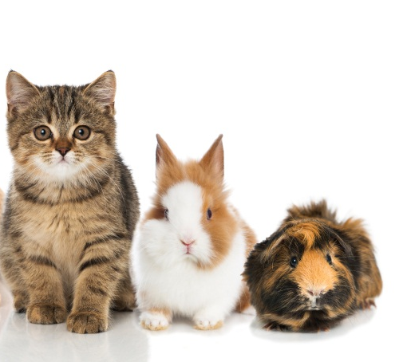
Look at the pictures. Study the adjectives.
Mary has three pets. Their names are Catty, Bunny and Fluffy.
Fluffy is big. Bunny is bigger than Fluffy , but Caty is the biggest.

Slide 9

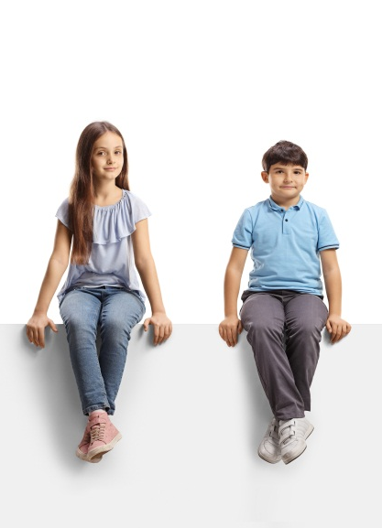
Look at the pictures. Study the adjectives.
I have two siblings. Here are my siblings.
Dean is young. Lily is younger than Dean, but Sam is the youngest of all

Slide 10
Here are some adjectives with their comparative and superlative forms.
Adjective | Comparative | Superlative
Cheap | Cheaper | Cheapest
Old | Older | Oldest
Slow | Slower | Slowest
Clever | Cleverer | Cleverest
Thick | Thicker | Thickest

Slide 11
You can use either the –er and -est forms or the more and most forms for the following words.
stupid stupider stupidest
stupid more stupid most stupid
polite politer politest
polite more polite most polite

Slide 12
GOOD JOB!

